Slide 1
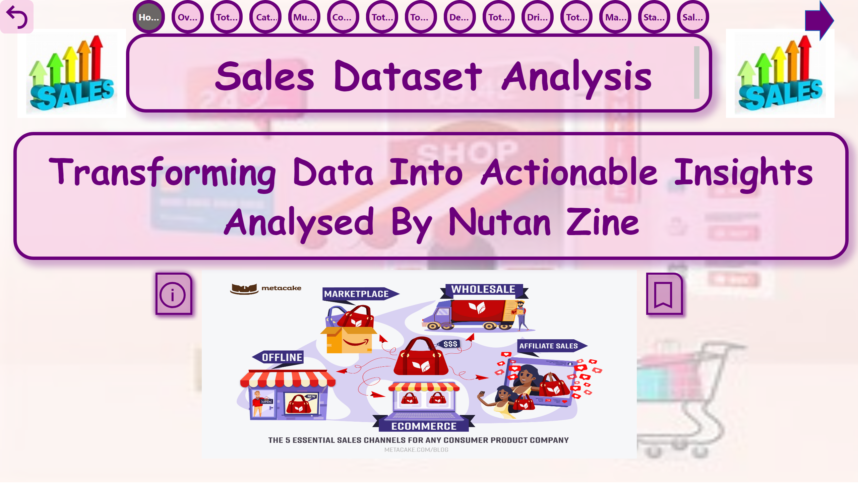
Home
Notes:
textbox
No alt text provided
image
No alt text provided
image
No alt text provided
shape
No alt text provided
image
No alt text provided
textbox
No alt text provided
actionButton
No alt text provided
actionButton
No alt text provided
pageNavigator
No alt text provided
actionButton
No alt text provided

Slide 2
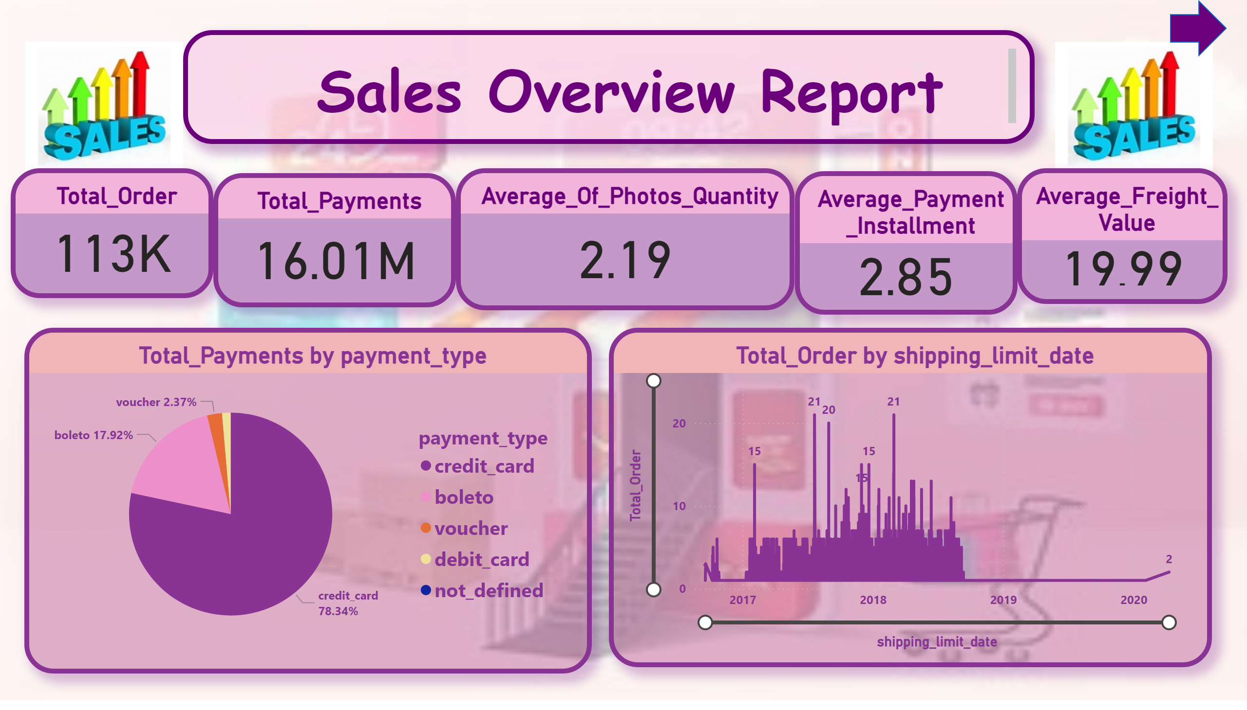
Overview
Notes:
textbox
No alt text provided
image
No alt text provided
image
No alt text provided
Total_Order
No alt text provided
Total_Payments
No alt text provided
Average_Of_Photos_Quantity
No alt text provided
Average_Payment_Installment
No alt text provided
Average_Freight_Value
No alt text provided
pieChart
No alt text provided
lineChart
No alt text provided
shape
No alt text provided

Slide 3
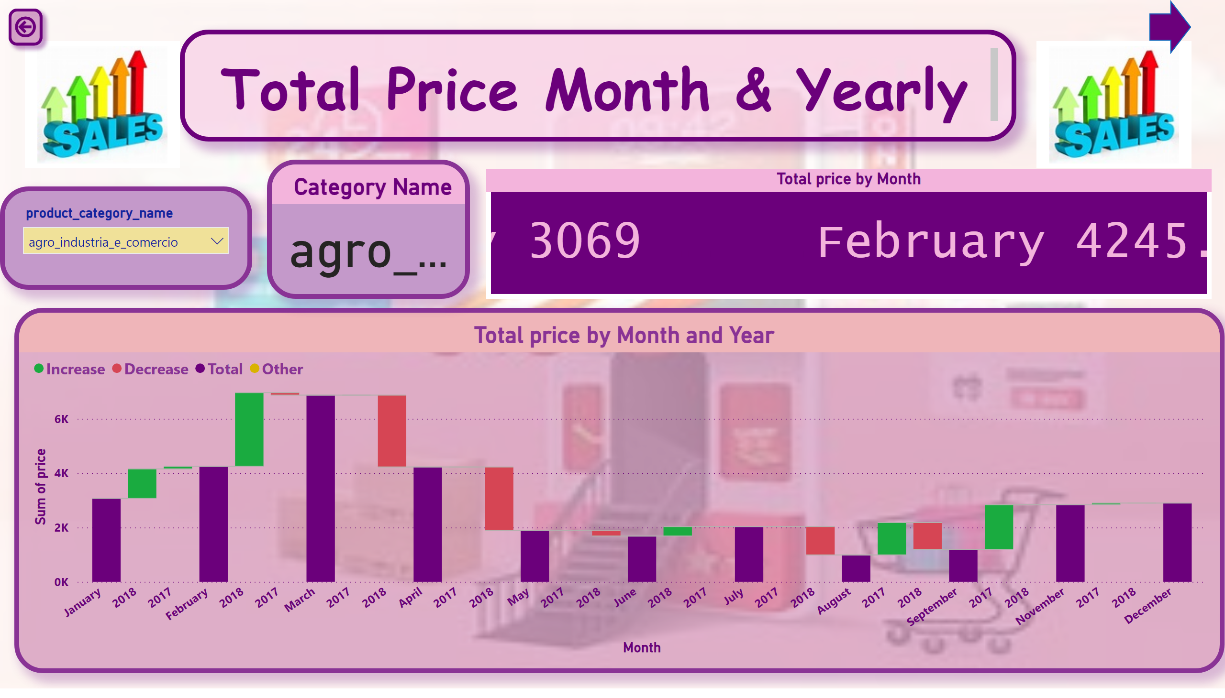
Total Price Month & Yearly
Notes:
textbox
No alt text provided
image
No alt text provided
image
No alt text provided
actionButton
No alt text provided
Total price by Month and Year
No alt text provided
slicer
No alt text provided
Category Name
No alt text provided
Total price by Month
No alt text provided
shape
No alt text provided

Slide 4
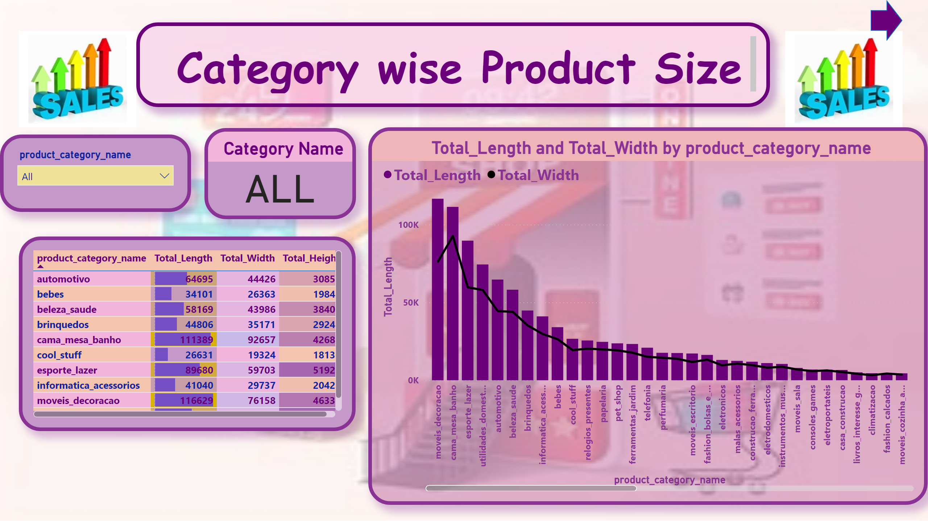
Category wise Product Size
Notes:
textbox
No alt text provided
image
No alt text provided
image
No alt text provided
slicer
No alt text provided
Category Name
No alt text provided
tableEx
No alt text provided
lineStackedColumnComboChart
No alt text provided
shape
No alt text provided

Slide 5
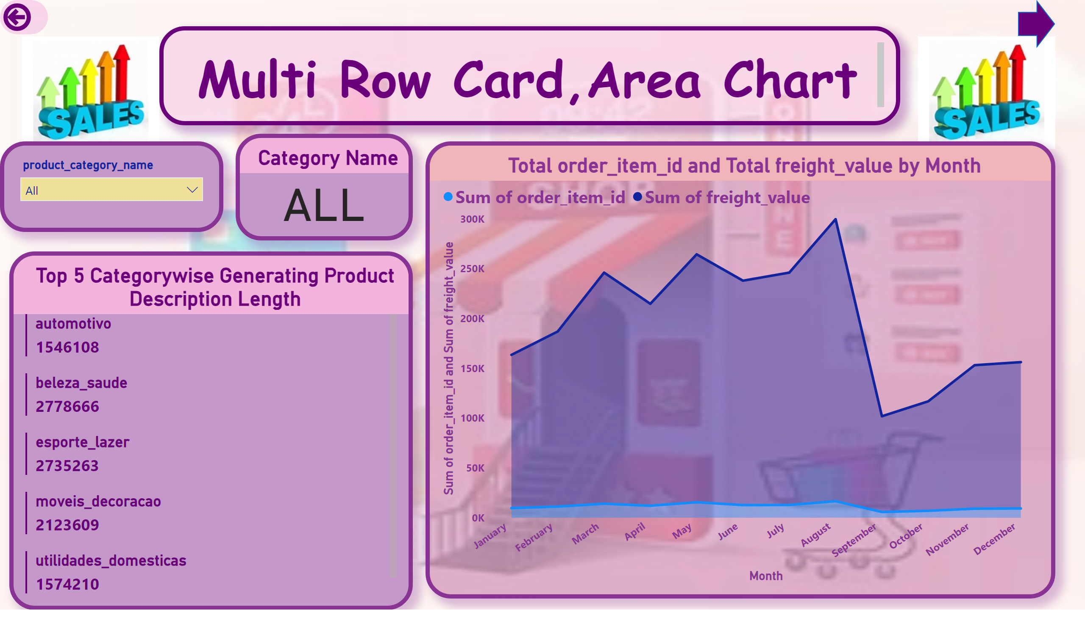
Multi Row Card, Area Chart
Notes:
textbox
No alt text provided
image
No alt text provided
image
No alt text provided
slicer
No alt text provided
shape
No alt text provided
Total order_item_id and Total freight_value by Month
No alt text provided
Top 5 Categorywise Generating Product Description Length
No alt text provided
actionButton
No alt text provided
Category Name
No alt text provided

Slide 6
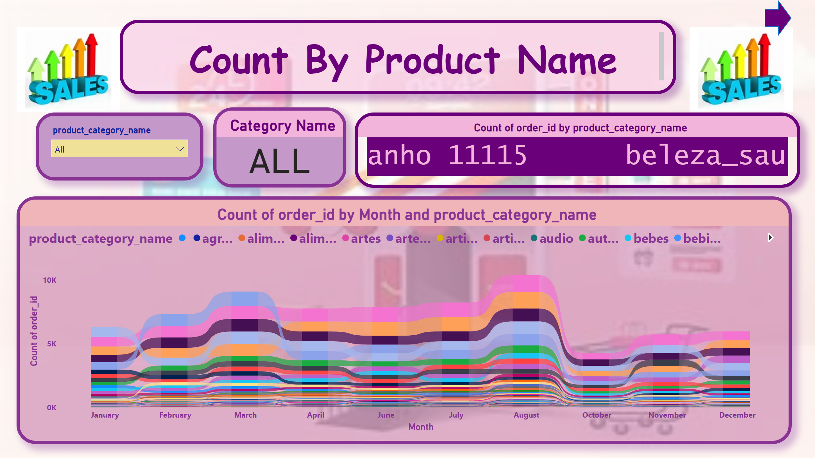
Count By Product Name
Notes:
textbox
No alt text provided
image
No alt text provided
image
No alt text provided
ribbonChart
No alt text provided
slicer
No alt text provided
Category Name
No alt text provided
ScrollingTextVisual1448795304508
No alt text provided
shape
No alt text provided

Slide 7
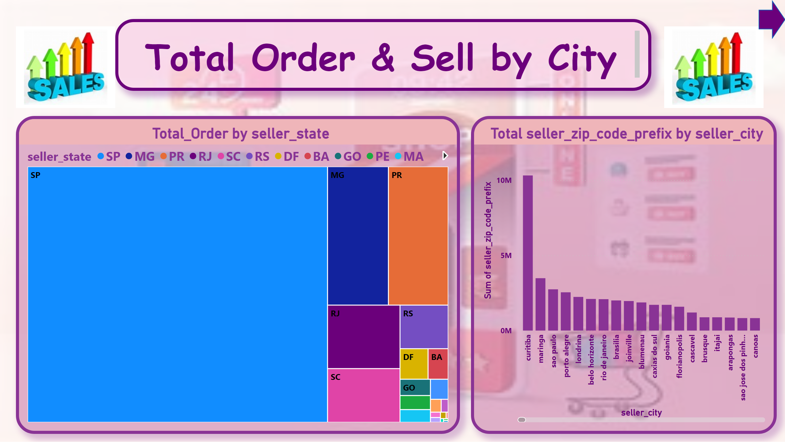
Total Order & Sell by City
Notes:
textbox
No alt text provided
image
No alt text provided
image
No alt text provided
treemap
No alt text provided
Total seller_zip_code_prefix by seller_city
No alt text provided
shape
No alt text provided

Slide 8
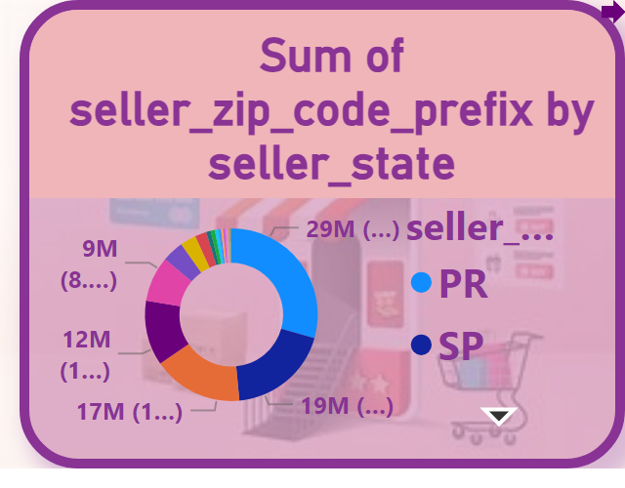
Tooltip
Notes:
donutChart
No alt text provided
shape
No alt text provided

Slide 9
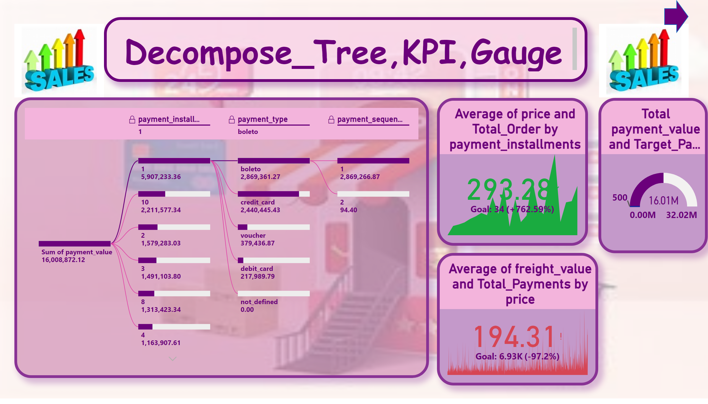
Decompose_Tree,KPI,Gauge
Notes:
textbox
No alt text provided
image
No alt text provided
image
No alt text provided
decompositionTreeVisual
No alt text provided
kpi
No alt text provided
kpi
No alt text provided
Total payment_value and Target_Payment_Value
No alt text provided
shape
No alt text provided

Slide 10
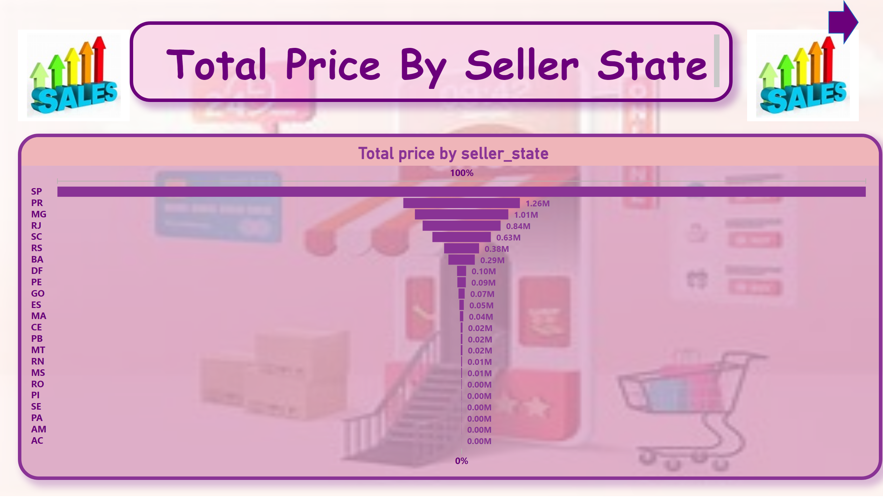
Total Price By Seller State
Notes:
textbox
No alt text provided
image
No alt text provided
image
No alt text provided
Total price by seller_state
No alt text provided
shape
No alt text provided

Slide 11
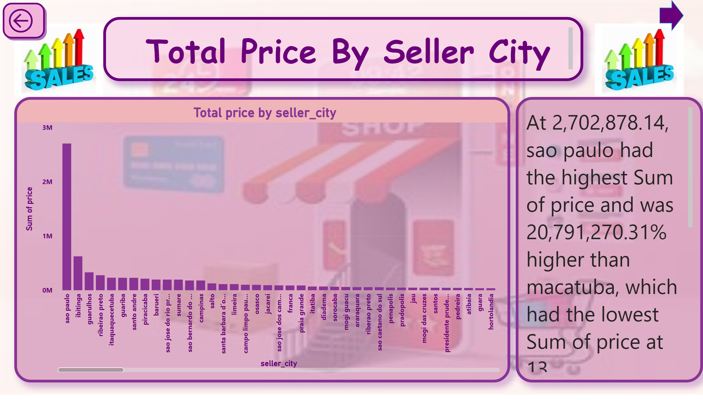
Drillthrough
Notes:
textbox
No alt text provided
image
No alt text provided
image
No alt text provided
Total price by seller_city
No alt text provided
actionButton
No alt text provided
textbox
No alt text provided
shape
No alt text provided

Slide 12
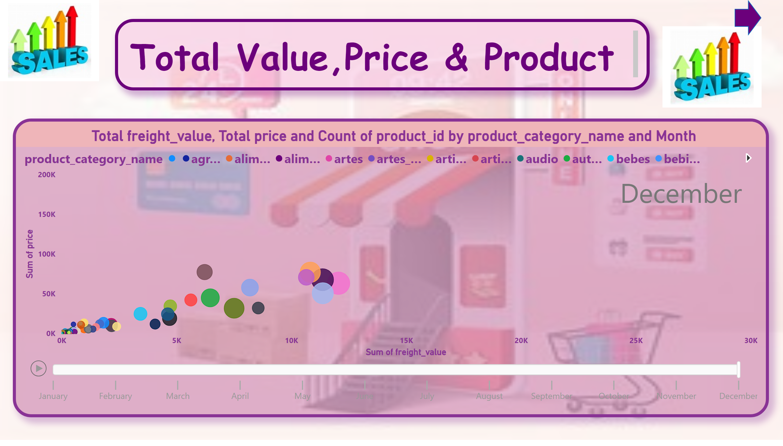
Total Value,Price & Product
Notes:
textbox
No alt text provided
image
No alt text provided
image
No alt text provided
Total freight_value, Total price and Count of product_id by product_category_name and Month
No alt text provided
shape
No alt text provided

Slide 13
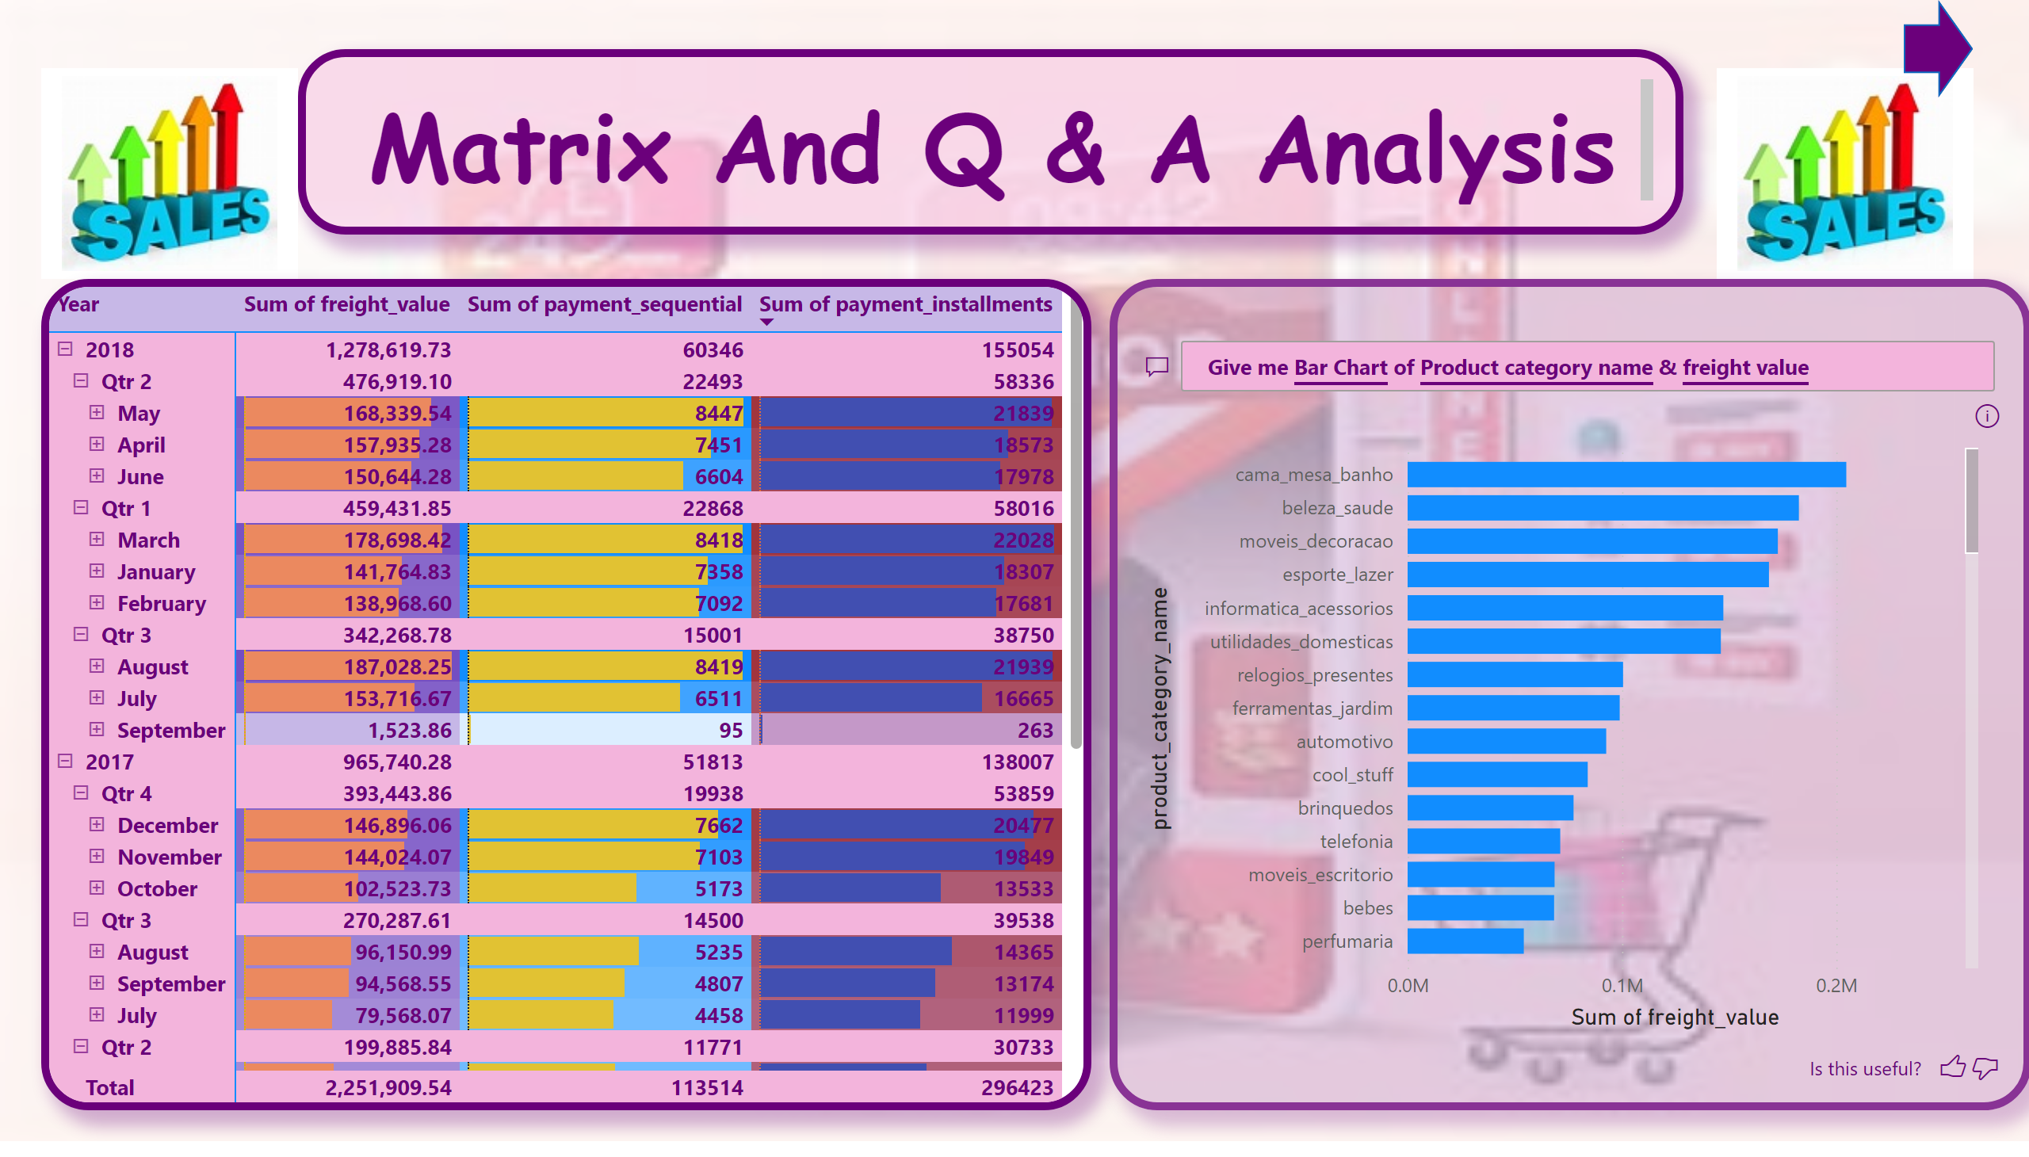
Matrix And Q & A Analysis
Notes:
textbox
No alt text provided
image
No alt text provided
image
No alt text provided
pivotTable
No alt text provided
qnaVisual
No alt text provided
shape
No alt text provided

Slide 14
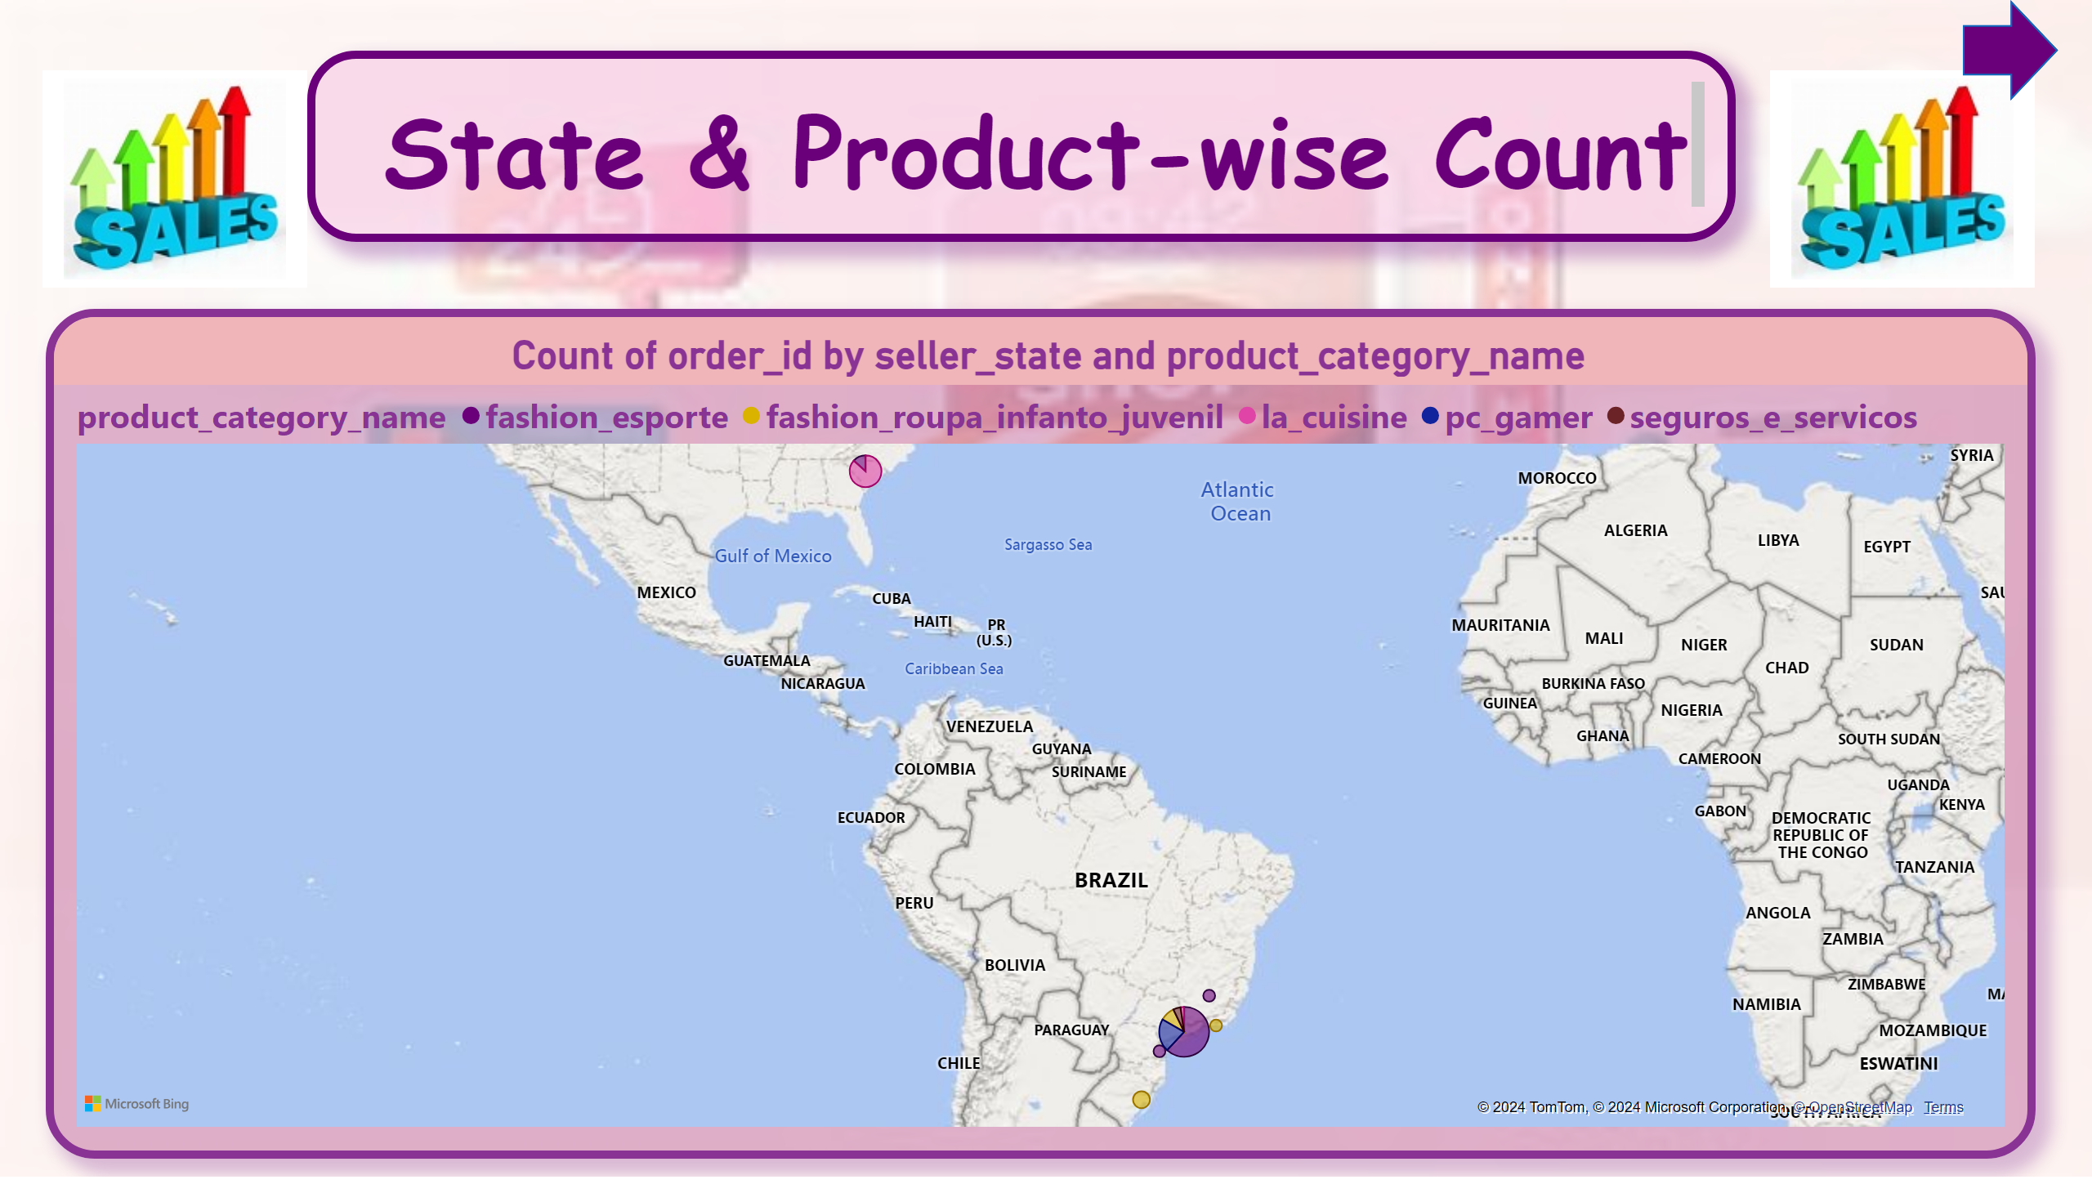
State & Product-wise Count
Notes:
textbox
No alt text provided
image
No alt text provided
image
No alt text provided
map
No alt text provided
shape
No alt text provided

Slide 15
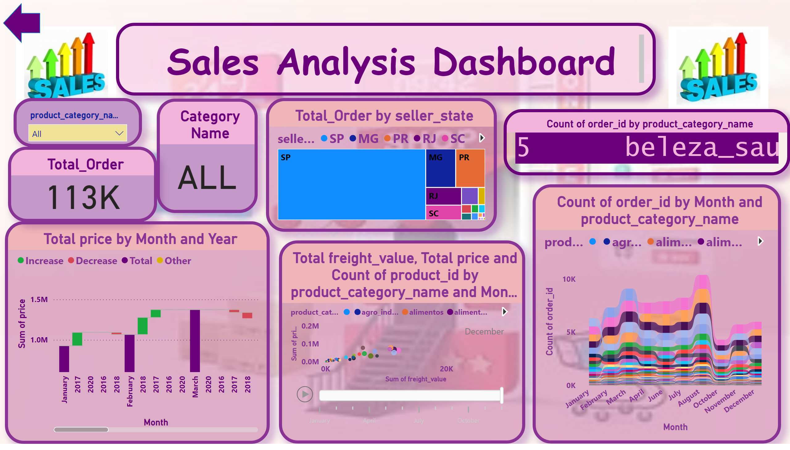
Sales Analysis Dashboard
Notes:
textbox
No alt text provided
image
No alt text provided
image
No alt text provided
shape
No alt text provided
Total price by Month and Year
No alt text provided
slicer
No alt text provided
Category Name
No alt text provided
ribbonChart
No alt text provided
treemap
No alt text provided
Total freight_value, Total price and Count of product_id by product_category_name and Month
No alt text provided
ScrollingTextVisual1448795304508
No alt text provided
Total_Order
No alt text provided

